Slide 1
CPS 235 Object Oriented Programming Paradigm
Lecturer Rabia Khan
Pointers

Slide 2

What Is A Pointer?
Simple int and float variables operate pretty naturally. An int variable is like a box which can store a single int value such as 42.
In a drawing, a simple variable is a box with its current value drawn inside.
A pointer works a little differently— it does not store a simple value directly. Instead, a pointer stores a reference to another value.

Slide 3
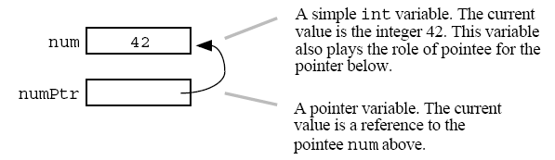
What Is A Pointer?
The following drawing shows two variables: num and numPtr. The simple variable num contains the value 42 in the usual way. The variable numPtr is a pointer which contains a reference to the variable num.
The numPtr variable is the pointer and num is its pointee. What is stored inside of numPtr? Its value is not an int. Its value is a reference to an int.

Slide 4

Pointer Variables
Pointer variables are declared just like any other variable. The declaration gives the type and name of the new variable and reserves memory to hold its value.
The declaration does not assign a pointee for the pointer — the pointer starts out with a bad value.

Slide 5
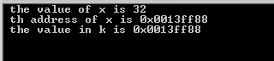
Example
Lets see what does a pointer really contain??
int main()
{
int x=32;
int * k; //make a pointer to int
k=&x; // address of x is saved in k
cout<<" the value of x is "<< x;
cout<< "\n th address of x is "<<&x;
cout<<" \n the value in k is "<<k;
getch();
return 0;
}

Slide 6
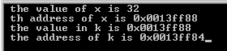
Example
Does “k” have its own address then??
  Obviously!! ‘k’ is stored somewhere in memory and has its own address!
int main()
{
int x=32;
int * k;
k=&x;
cout<<" the value of x is "<< x;
cout<< "\n th address of x is "<<&x;
cout<<" \n the value in k is "<<k;
cout<<" \n the address of k is "<<&k;
getch();
return 0;
}

Slide 7
Pointer variables
  int *x; // pointer to an int
  char* y; //pointer to a char
  double* z; //pointer to a double
  char *ptr1, *ptr2, *ptr3; //three variables of type char*
You cannot do the following:
  double x = 15;
  int* p = &x; //compile-time error, the types do not match!
CPS235:Pointers

Slide 8
Pointer Dereference
The "dereference" operation follows a pointer's reference to get the value of its pointee.
The value of the dereference of numPtr above is 42. When the dereference operation is used correctly, it's simple. It just accesses the value of the pointee.
The only restriction is that the pointer must have a pointee for the dereference to access. Almost all bugs in pointer code involve violating that one restriction. A pointer must be assigned a pointee before dereference operations will work.

Slide 9
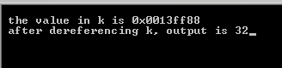
Example
int main()
{
int x=32;
int * k;
k=&x;
cout<<" \n the value in k is "<<k;
cout<<" \n after dereferencing k, output is "<<*k;
getch();
return 0;
}

Slide 10
The NULL Pointer
The constant NULL is a special pointer value which encodes the idea of "points to nothing."
It turns out to be convenient to have a well defined pointer value which represents the idea that a pointer does not have a pointee. It is a runtime error to dereference a NULL pointer
The C language uses the symbol NULL for this purpose. NULL is equal to the integer constant 0, so NULL can play the role of a Boolean false. Official C++ no longer uses the NULL symbolic constant — use the integer constant 0 directly. Java uses the symbol null.
NULL is the best default value to assign to a pointer if you cannot assign it the address of a variable. A smart programmer will check for NULL before using the pointer.

Slide 11
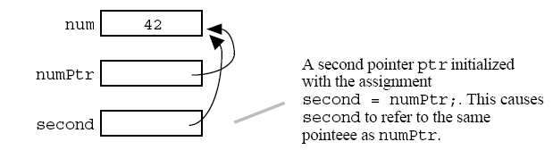
Pointer Assignment
The assignment operation (=) between two pointers makes them point to the same pointee. Assigning one pointer to another makes them point to the same thing.
The example below adds a second pointer, second, assigned with the statement second = numPtr;
The result is that second points to the same pointee as numPtr. (both the pointers will have different memory addresses)
Assignment between pointers does not change or even touch the pointees. It just changes which pointee a pointer refers to.

Slide 12
Assigning Pointers
In this example, when pZ is dereferenced, it lets us change the value of N:
int N = 26;
int * pN = &N; //compute address of N and give it to pN
int * pZ;
pZ = pN;
*pZ = 35; // now N = 35
CPS235:Pointers

Slide 13
Assigning Pointers
Assigning a value from one pointer to another can be done by dereferencing both pointers.
int N = 26;
int * pN = &N;
int Z = 0;
int * pZ = &Z;
*pZ = *pN; // First compute *pZ and then assign to it whatever is it *pN i.e. Z = 26
CPS235:Pointers

Slide 14
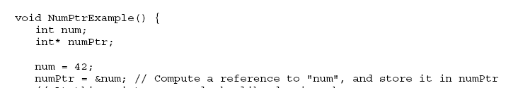
The & Operator — Reference To
In C++ you can get the address of a variable with the “&” operator.
There are several ways to compute a reference to a pointee suitable for storing in a pointer. The simplest way is the & operator. The & operator can go to the left of any variable, and it computes a reference to that variable. The code below uses a pointer and an & to produce the earlier num/numPtr example.

Slide 15
Example
MEMORY
int foo;
int *x;
foo = 123;
x = &foo;
Address
0
1
2
3
4
5
81345
81346
81347
foo
123
...
...
x
3

Slide 16
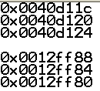
Addresses and the &(address-of) operator
#include<iostream>
#include<conio>
int x = 7;
int y = 8;
int z = 10;
void main()
{
int x1 = 7;
int y1 = 8;
int z1 = 9;
cout<<&x<<endl;
cout<<&y<<endl;
cout<<&z<<endl;
cout<<endl<<&x1<<endl;
cout<<&y1<<endl;
cout<<&z1<<endl;
getch();
}
CPS235:Pointers

Slide 17
Dereference Operator
The dereference operator (*) for a pointer obtains the contents of the variable that is referenced by a pointer.
int N = 26;
int * pN = &N;
cout << *pN << endl; // "26"
CPS235:Pointers

Slide 18
Dereference Operator
The dereference operator can also be used to modify the contents of the referenced variable.
int N = 26;
int * pN = &N;
*pN = 35; // this will change the value of N instead
cout << *pN << endl; // 35
cout << N << endl; // 35
int y = *pN + 10;
cout << y << endl; //45
(*pN)++;
cout << *pN << endl; //36
cout << N << endl; //36
CPS235:Pointers

Slide 19
Two ways of using the asterik (*)
  int *p; //declaration: a pointer to an int
  *p = 37; //indirection/dereferencing a pointer to access the value of the variable pointed to by p
CPS235:Pointers

Slide 20
In short . . .
Declares a pointer
to an integer
int x = 10;
int *p ;
p = &x;
*p = 20;
& is address operator
gets address of x
* dereference operator
gets value at p
CPS235:Pointers

Slide 21
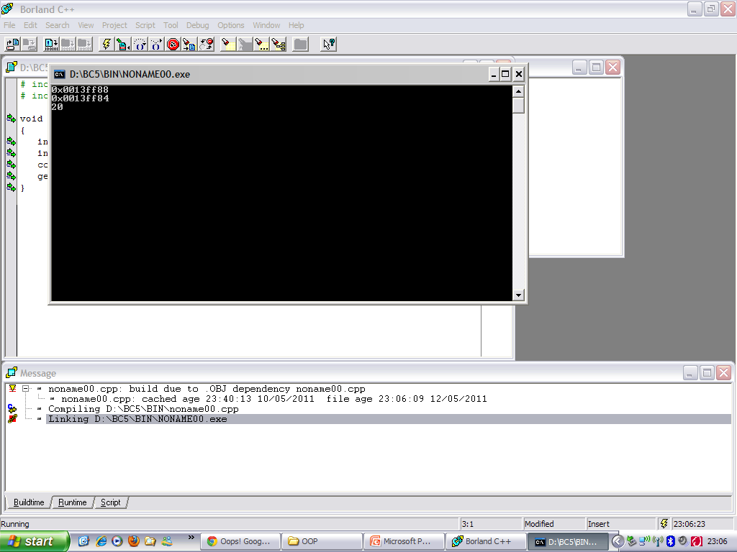
What would be the output?
void main()
{
int x = 20; //x is at address 0x0013ff88
int* p = &x; //p is at address 0x0013ff84
cout<<p<<endl<<&p<<endl<<*p;
getch();
}
CPS235:Pointers

Slide 22
Uninitialized Pointers
A pointer must have a value before you can dereference it
int *x;
*x=3;
int foo;
int *x = foo;
*x=3;
Run-time ERROR!!!
x doesn’t point to anything!!!
this is fine
x points to foo
CPS235:Pointers

Slide 23
An Example
What does the memory look like after each statement?
void PointerTest() {
// allocate three integers and two pointers
int a = 1;
int b = 2;
int c = 3;
int* p;
int* q;
p = &a; // set p to refer to a
q = &b; // set q to refer to b
c = *p; // retrieve the value stored in the variable pointed to by p (i.e., a)and put it in c
p = q; // change p so that it points to the variable to which q is pointing
*p = 13; // dereference p to set the value of the variable pointed to by p (i.e., b)to 13 (*q is now 13 also)

Slide 24
Pointers to Objects
A pointer can also be used to point to an object of a user-defined class
class employee
{
int id;
public:
void display() { cout<<id; }
};
void main()
{
employee e1;
employee* ptr = &e1; //ptr is a pointer to an employee object
(*ptr).display(); //dereference the pointer to get the object pointed to by the pointer
ptr -> display(); //access object members using -> operator
}
CPS235:Pointers

Slide 25
Pointers and Arrays
The name of an array is in fact the address of the first element in the array
Saying array[3] tells the compiler to start with the memory address of the first element in array, jump three elements down in memory, and dereference
In other words, it says to return the element that is 3 away from the starting element
So if you have
  int array[5] = {1,2,3,4,5};
  cout<<array; is equivalent to cout<<&array[0];
  (because array is actually address of first element)
  cout << array[2]; is equivalent to cout<<*(array+2)
CPS235:Pointers

Slide 26
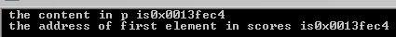
Example
int main ()
{
int scores[50];
int * p = scores;
cout<<" the content in p is" <<p;
cout<<"\n the address of first element in scores is"<<&scores[0]<<endl;
getch();
return 0;
}
CPS235:Pointers

Slide 27
Pointers and Arrays
The name of the array is infact a constant pointer
So, if you have int array[5] = {1,2,3,4,5};
you cannot write an expression of the following form
*(array++) ; //always use parentheses to avoid ambiguity
since this is incrementing the array variable but that is a constant
We can however write int* pArray = array;
And then use a statement pArray++;
Here, array is a constant pointer whereas pArray is a normal pointer
What happens when you write *(array+2) above?
Does it cause 2 bytes to be added to the address of the first element of the array?
CPS235:Pointers

Slide 28
Pointer arithmetic
Integer math operations can be used with pointers
If you increment a pointer, it will be increased by the size of whatever it points to.
int a[5];
int *ptr = a;
*(ptr+2)
*(ptr+4)
*ptr
a[0] a[1] a[2] a[3] a[4]
CPS235:Pointers

Slide 29
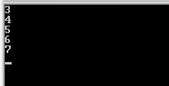
Traversing an Array
C and C++ programmers often use pointers to traverse arrays. At one time, such code ran more efficiently, but recent optimizing compilers make array subscripts just as efficient.
int scores[5]={3,4,5,6,7};
int * p = scores;
for( int i = 0; i < 5; i++)
{
cout << *p << endl;
p++; // increment the pointer
}

Slide 30
Output?
  int main ()
  {
  int numbers[5];
  int * p;
  p = numbers;
  *p = 10;
  p++;
  *p = 20;
  p = &numbers[2]; *p = 30;
  p = numbers + 3; *p = 40;
  p = numbers; *(p+4) = 50;
  for (int n=0; n<5; n++)
    cout << numbers[n] << ", ";
    return 0;
  }
CPS235:Pointers

Slide 31
What are the values of a and b in main?
    void swap( int x, int y)
    { int tmp;
    tmp = x;
    x = y;
    y = tmp;
    }
    void main()
    {
    int a = 5;
    int b = 10;
    swap(a,b);
    }
    void swap( int *x, int *y) {
    int tmp;
    tmp = *x;
    *x = *y;
    *y = tmp;
    }
    void main()
    {
    int a = 5;
    int b = 10;
    swap(&a,&b);
    }
PASS BY VALUE
PASS BY POINTERS
    void swap( int &x, int &y) { int tmp;
    tmp = x;
    x = y;
    y = tmp;
    }
    void main()
    {
    int a = 5;
    int b = 10;
    swap(a,b);
    }
PASS BY REFERENCE
CPS235:Pointers

Slide 32
Pointers and Functions
Three ways of passing parameters to a function
Pass by value: does not change the values of the variables in the calling program
Pass by reference: modifies the values of the variables in the calling program
Pass by pointer: also modifies the values of the variables in the calling program
CPS235:Pointers

Slide 33
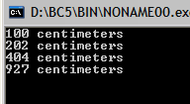
Passing Arrays as Arguments using Pointers
void centimize(double*);
void main()
{
double array[4] = {10.0, 20.2, 40.4, 92.7};
centimize(array); //passing address of first element of array
for (int j = 0; j<4; j++)
cout<<array[j]<<" centimeters"<<endl;
getch();
}
void centimize(double* ptrd)
{
for (int j = 0; j<4; j++)
*(ptrd++) *= 10; //increment, compute the content and multiply by 10 and save
}
CPS235:Pointers

Slide 34
Pointers and the const modifier
Two places for const
int a;
const int* p =&a; //pointer to constant int
++p; //OK
++(*p); //ERROR: can’t modify const a
int* const q =&a; //constant pointer to int
++q; //ERROR: can’t modify const q
++(*q); //OK
const int* const r = &a; //constant pointer to constant int
++r; //ERROR: can’t modify const r
++(*r); //ERROR: can’t modify const a
CPS235:Pointers

Slide 35
Which statements are OK?
void MySub( const int * A )
{
*A = 50;
A++;
}
ERROR!
OK!
void MySub( int * const A )
{
*A = 50;
A++;
}
OK!
ERROR!
CPS235:Pointers

Slide 36
POINTERS AND DYNAMIC MEMORY
CPS235:Pointers

Slide 37
Problem with static memory
Up to this point, the memory we've been using has been static memory. What does this mean?
Static memory is memory that is set aside automatically by the compiler for your program. When you declare a variable, such as the int arr[100] array we declared in the above program, you're telling the computer to set aside space for 100 integers. The problem with this is that the computer needs to know how much memory to set aside before your program starts running. When you run your program, the computer gives it the memory it needs to hold all of the variables you've declared; in other words, you've statically allocated memory.
CPS235:Pointers

Slide 38
Find the error
void main()
{
int size;
cout<<"how many numbers do you want to enter?";
cin>>size;
int ptr_to_array [size];
for (int i=0; i<size; i++){
ptr_to_array[i] = 0;
cout<<ptr_to_array[i]<<'\t';
}
delete [] ptr_to_array; //free the heap memory
getch();
}
//error : Constant expression required!
CPS235:Pointers

Slide 39
Dynamic memory allocation and Pointers
If we need memory to be allocated at run-time, “DYNAMIC MEMORY ALLOCATION” is the solution!
When we ask the computer for memory dynamically, what does it return?
An address!
When we ask the computer for memory, it sees what memory it has available. The operating system will set aside the amount of memory we requested and give us that memory's address so that we can then use it. How do we store an address? In a pointer.
CPS235:Pointers

Slide 40
Rewriting code: Declaring array size at run-time
void main()
{
int* ptr_to_array;
int size;
cout<<"how many numbers do you want to enter?";
cin>>size;
ptr_to_array = new int[size]; //create an int array on the heap
for (int i=0; i<size; i++){
ptr_to_array[i] = 0;
cout<<ptr_to_array[i]<<'\t';
}
delete [] ptr_to_array; //free the heap memory
getch();
}
CPS235:Pointers

Slide 41
Dynamic Allocation
Use dynamic allocation to create an object at runtime
  C++ uses the new operator
  C uses malloc keyword
The object is stored in a large free memory area named the heap (or free store)
The object remains on the heap either until you remove it or the program ends
The delete operator erases an object from the heap
CPS235:Pointers

Slide 42
Allocating memory on the heap
The heap is a large area of memory available for use by the program
The program can request areas, or "blocks", of memory for its use within the heap
In order to allocate a block of some size, the program makes an explicit request by calling the heap allocation function
The allocation function reserves a block of memory of the requested size in the heap and returns a pointer to it
CPS235:Pointers

Slide 43
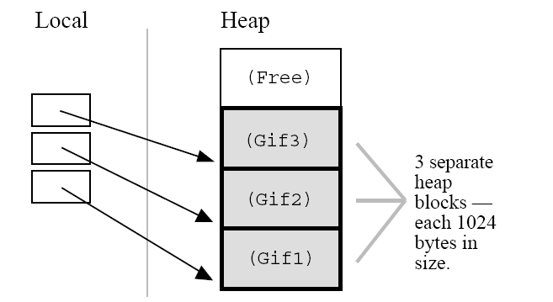
Allocating memory on the heap
Suppose a program makes three allocation requests to allocate memory to hold three separate GIF images in the heap each of which takes 1024 bytes of memory
CPS235:Pointers

Slide 44
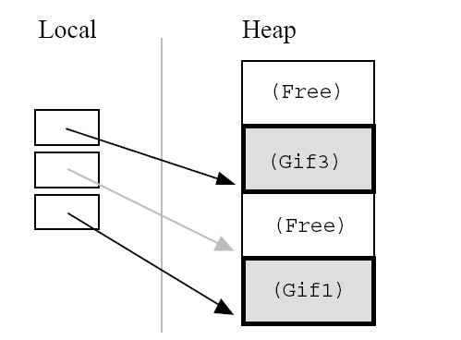
De-allocating heap memory
Here's what the heap would look like if the program de-allocates the second of the three blocks
After the de-allocation, the pointer continues to point to the now de-allocated block
The program must not access the deallocated block
This is why the pointer is drawn in gray — the pointer is there, but it must not be used
CPS235:Pointers

Slide 45
De-allocating heap memory
When the program is finished using a block of memory, it makes an explicit deallocation request to indicate that the program is now finished with that block
The heap manager updates its private data structures to show that the area of memory occupied by the block is free again and so may be re-used to satisfy future allocation requests
CPS235:Pointers

Slide 46
The new operator
Two forms:
  new datatype ;
  new datatype[IntExpression] ; //for arrays
int* intPtr = new int;
//creates a variable of type int on the heap and stores its address in intPtr
char* nameStr = new char[6];
//creates a six-element character array on the heap and stores the array’s base address in nameStr
CPS235:Pointers

Slide 47
Dynamic Variables
A dynamic variable is unnamed and cannot be directly addressed
  It must be indirectly accessed through the pointer returned by the new operator
  int* intPtr = new int;
  *intPtr = 37;
  cout<<*intPtr;
CPS235:Pointers

Slide 48
The delete operator
Two forms:
  delete datatype ;
  delete [] datatype; //for arrays
delete intPtr;
//gives back the variable pointed to by intPtr to the free store to make it reusable
delete [] nameStr;
//gives back the array pointed to by nameStr to the free store to be used again
CPS235:Pointers

Slide 49
The delete operator
Deleting the memory does not delete the pointer that points to it (intPtr in the previous example) and does not change the address value in the pointer
However, this address is no longer valid; the memory it points to may be changed into something entirely different
So, don’t use pointers to memory that has been deleted
CPS235:Pointers

Slide 50
Use of new with strings
void main()
{
char* str = "Welcome to MCS !";
int len = strlen(str);
char* ptr = new char[len+1]; //+1 to make room for the null character to terminate the string
strcpy(ptr,str); //copy str to new memory area on the heap
cout<<"ptr = "<<ptr;
delete[] ptr; //release ptr's memory
getch();
}
CPS235:Pointers

Slide 51
new and delete with Objects
The new operator returns the address of a new object. The delete operator erases the object and makes it unavailable.
Student constructor called
Student * pS1 = new Student;
Student * pS2 = new Student(“John”,205);
.
.
// use the student for a while...
.
.
delete pS1; // memory gone!
delete pS2;
CPS235:Pointers

Slide 52
new and delete with Objects
class foo
{
public:
foo();
foo(int);
int func();
};
void main()
{
foo* fp1 = new foo;
foo* fp2 = new foo(100);
foo* fp3 = new foo[100];
delete fp1;
delete fp2;
delete [] fp3;
}
CPS235:Pointers

Slide 53

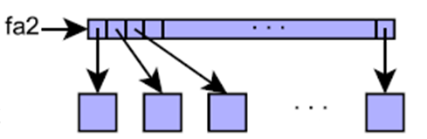
new and delete with Objects
foo f;
f.func();
foo* fptr = new foo;
fptr->func();
foo* fa1 = new foo[100];
fa1[50].func();
foo* fa2[100];
for(int i = 0; i<100; i++)
fa2[i] = new foo(i);
for(int i =0; i<100; i++)
fa1[i].func();
for(int i =0; i<100; i++)
fa2[i]->func();
CPS235:Pointers

Slide 54
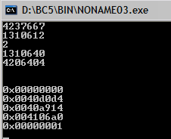
Analogous to previous example
#include <iostream.h>
#include <conio.h>
void main()
{
int * myarray[5];
int myarray1[5];
for(int i = 0; i<5; i++)
{
cout<<myarray1[i]<<endl;
}
cout<<endl<<endl;
for(int i = 0; i<5; i++)
{
cout<<myarray[i]<<endl;
}
getch();
}

Slide 55
Using new in Functions
If you create an object inside a function, you may have to delete the object inside the same function. In this example, variable pS goes out of scope at the end of the function block
void MySub()
{
Student * pS = new Student;
// use the Student for a while...
delete pS; // delete the Student
} // pS disappears
CPS235:Pointers

Slide 56
Function Returning an Address
A function can return the address of an object that was created on the heap. In this example, the function's return type is pointer to Student.
Student * MakeStudent()
{
Student * pS = new Student;
return pS;
}
(more)
CPS235:Pointers

Slide 57
Receiving a Pointer
(continued)...
The caller of the function can receive the address and store it in a pointer variable. As long as the pointer remains active, the Student object is accessible.
Student * pS;
pS = MakeStudent();
// now pS points to a Student
CPS235:Pointers

Slide 58
Memory Leaks
A memory leak is an error condition that is created when an object is left on the heap with no pointer variable containing its address. This might happen if the object's pointer goes out of scope:
void MySub()
{
Student * pS = new Student;
// use the Student for a while...
} // pS goes out of scope
(the Student is still left on the heap)
How to avoid memory leak??
For every "new," you should use a "delete" so that you free the same memory you allocated
CPS235:Pointers

Slide 59
Dangling Pointers
A dangling pointer is created when you delete its storage and then try to use the pointer. It no longer points to valid storage and may corrupt the program's data
double * pD = new double;
*pD = 3.523;
.
.
delete pD; // pD is dangling...
.
.
*pD = 4.2; // run-time error!
CPS235:Pointers

Slide 60
Avoid Dangling Pointers
To avoid using a dangling pointer, assign NULL to a pointer immediately after it is deleted.
And, of course, check for NULL before using the pointer.
delete pD;
pD = NULL;
.
.
if( pD != NULL ) // check it first...
*pD = 4.2;
CPS235:Pointers

Slide 61
Identify where you have a memory leak and a dangling pointer?
int* ptr1 = new int;
int* ptr2 = new int;
*ptr2 = 44;
*ptr1 = *ptr2;
ptr1 = ptr2;
delete ptr2;
CPS235:Pointers

Slide 62
Modified code
int* ptr1 = new int;
int* ptr2 = new int;
*ptr2 = 44;
*ptr1 = *ptr2;
delete ptr1; //to avoid memory leak
ptr1 = ptr2;
delete ptr2;
ptr1 = ptr2 = NULL;//to avoid dangling ptr
CPS235:Pointers

Slide 63
Array of Pointers
An array of pointers usually contains the addresses of dynamic data objects. This keeps the storage used by the array itself quite small, and puts most of the data on the heap.
Student * array[10];
for(int i = 0; i < 10; i++)
{
array[i] = new Student;
}
diagram
CPS235:Pointers

Slide 64
Array of Pointers
Heap
Stack
Student
Student
Student
Student
Student
Student
Student
Student
array [ ]
Student
Student
CPS235:Pointers

Slide 65
Creating an Array on the Heap
You can create an entire array on the heap, using the new operator. Just remember to delete it before the program exits. Include "[ ]" before the array name in the delete statement.
void main()
{
double * samples = new double[10];
// samples is now an array....
samples[0] = 36.2;
delete [] samples;
}
array size
CPS235:Pointers

Slide 66
The “this” pointer
Use the "this" pointer to discover the location of a class instance. Like any pointer, it stores an address.
In the following example, member function GetAddress() of C++ class X returns the address of a given instance of class X:
class X{
public:
X* const GetAddress() const{
return this;
};
Remember this pointer is only accessible in non static member functions of the class. Can you think why???
CPS235:Pointers

Slide 67
Using “this” pointer
class alpha
{
private:
int data;
public:
alpha() {}
alpha(int d){data = d;}
void display() {cout<<'\n'<<data;}
void reveal() {cout<<"\nMy address is :"<<this; }
void tester()
{
this->data = 5; //same as data = 5;
cout<<'\n'<<this->data; //same as cout<<data;
}
alpha& operator= (alpha& a)
{
data = a.data;
cout<<"\nAssignment Operator";
return *this; //return reference to this alpha object
} };
CPS235:Pointers
Notes:
Another use of the this pointer is to enable cascaded member-function calls in which multiple functions are invoked in the same statement e.g.,
t.setHour( 18 ).setMinute( 30 ).setSecond( 22 );
Where these functions are defined as follows
Time & setHour( int h ) // note Time & return 31 { 32 hour = ( h >= 0 && h < 24 ) ? h : 0; // validate hour 33 return *this; // enables cascading 34 } // end function setHour 35 36 // set minute value 37 Time &Time::setMinute( int m ) // note Time & return 38 { 39 minute = ( m >= 0 && m < 60 ) ? m : 0; // validate minute 40 return *this; // enables cascading 41 } // end function setMinute 42 43 // set second value 44 Time &Time::setSecond( int s ) // note Time & return 45 { 46 second = ( s >= 0 && s < 60 ) ? s : 0; // validate second 47 return *this; // enables cascading 48 } //

Slide 68
Advantage of ‘this’ pointer
class Calc
{
private:
int m_nValue;
public:
Calc() { m_nValue = 0; }
void Add(int nValue) { m_nValue += nValue; }
void Sub(int nValue) { m_nValue -= nValue; }
void Mult(int nValue) { m_nValue *= nValue; }
int GetValue() { return m_nValue; }
};
void main()
{
Calc cCalc;
cCalc.Add(5);
cCalc.Sub(3);
cCalc.Mult(4);
}
What if we want to make a cascaded function call like:
cCalc.Add(5).Sub(3).Mult(4);
CPS235:Pointers

Slide 69
Advantage of ‘this’ pointer
If we make each function return *this, we can chain the calls together. Here is the new version of Calc with “chainable” functions:
class Calc
{
.....
Public :
Calc& Add(int nValue) { m_nValue += nValue; return *this; }
Calc& Sub(int nValue) { m_nValue -= nValue; return *this; }
Calc& Mult(int nValue) { m_nValue *= nValue; return *this; }
...}
CPS235:Pointers

